Slide 1


CARIBBEAN SECURITY
Security & Detection
Company Profile
April 2026 Edition
allenandco.ca · info@allenandco.ca · +1 (905) 703-6714

Slide 2

WHO WE ARE
Caribbean leaders in airport, security & emergency solutions
Founded in 2011, Allen + Co. Caribbean Inc. is a top-tier provider of integrated emergency, security and ground-support solutions, anchored in the Cayman Islands and serving the wider Caribbean.
Our leadership brings 80+ years of hands-on airport experience. We deliver internationally compliant equipment, services and training — tailored to the operational and environmental conditions of the region.
2011
80+
Established
Years of leadership experience
18+
24/7
Caribbean territories served
Maintenance & lifecycle support
Allen & Co · Company Profile · April 2026
allenandco.ca

Slide 3
WHERE WE OPERATE
An extensive Caribbean footprint
• Anguilla
• British Virgin Islands
• St. Kitts & Nevis
18
• Antigua
• Cayman Islands
• St. Lucia
• Aruba
• Curaçao
• St. Maarten
• Bahamas
• Dominica
• St. Vincent
• Barbados
• Grenada
• Trinidad & Tobago
• Bonaire
• Montserrat
• Turks & Caicos
Caribbean territories
across regional and international airport, government and security engagements
Allen & Co · Company Profile · April 2026
allenandco.ca

Slide 4
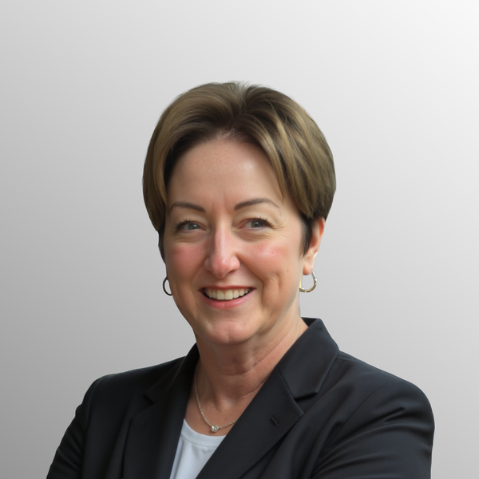
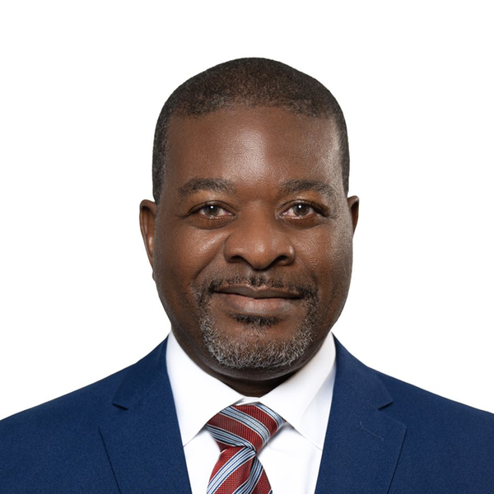
EXECUTIVE LEADERSHIP
People who have built Caribbean aviation
Maureen Allen
Mirto Breell
Chief Executive Officer
Chief Operations Officer
Trusted Caribbean aviation leader for over four decades.
Founder of multiple regional security, screening and ARFF platforms.
Long-standing partnerships with global manufacturers and public-safety agencies.
Hands-on, people-focused, accountable through the full lifecycle.
40+ years of Caribbean aviation operations and executive leadership.
Pilot, operator and regulator — led airline certification and built SMS programs.
Project Director, USD 175M SXM Terminal Reconstruction.
Drives modernisation across ARFF, security, compliance and collaboration.
Allen & Co · Company Profile · April 2026
allenandco.ca

Slide 5
OUR PARTNERS
Best-in-class manufacturers behind every solution
CEIA
SureScan
Viken
XRC
Electromagnetic threat detection — metal detectors, body scanners, liquid analysers.
AI-powered CT scanning for cabin baggage, cargo and checkpoint flow.
Backscatter and dual-energy X-ray for handheld, mobile and drive-through inspection.
Dual-view cabinet X-ray across the full parcel-to-pallet size range.
Plus: CIMC-Tianda · ITW GSE · City View · FESTI Toronto — partners across GSE, boarding bridges and emergency training.
Allen & Co · Company Profile · April 2026
allenandco.ca

Slide 6
WHAT WE DELIVER
Eleven product categories, one accountable partner
Walk-Through Metal Detectors
Handheld Metal Detectors
Body Security Scanners
Liquid Explosive Detectors
Dual-View Cabinet X-ray
CT Baggage Scanners
CT Cargo Scanners
Tray Return Systems
Handheld X-ray Imagers
Mobile / Vehicle Scanners
Fixed Drive-Through Scanners
Maintenance · Training · Lifecycle
Allen & Co · Company Profile · April 2026
allenandco.ca

Slide 7
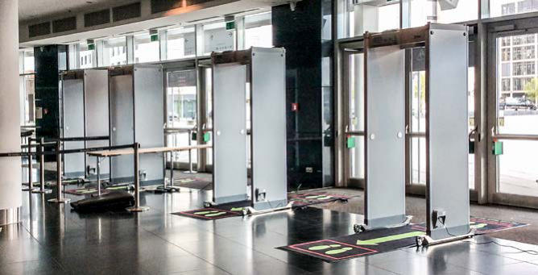
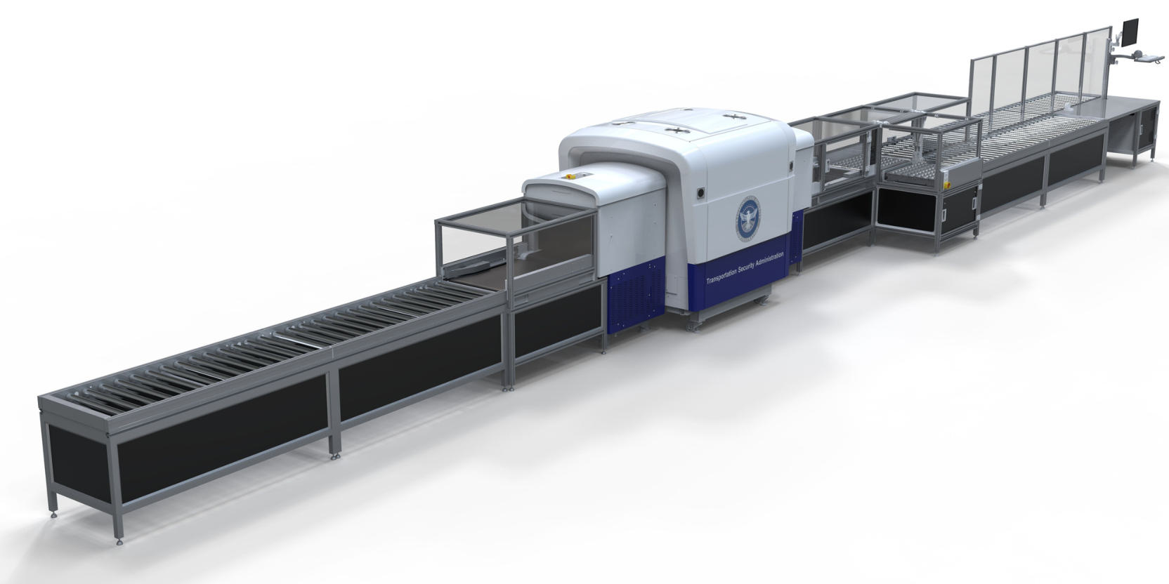
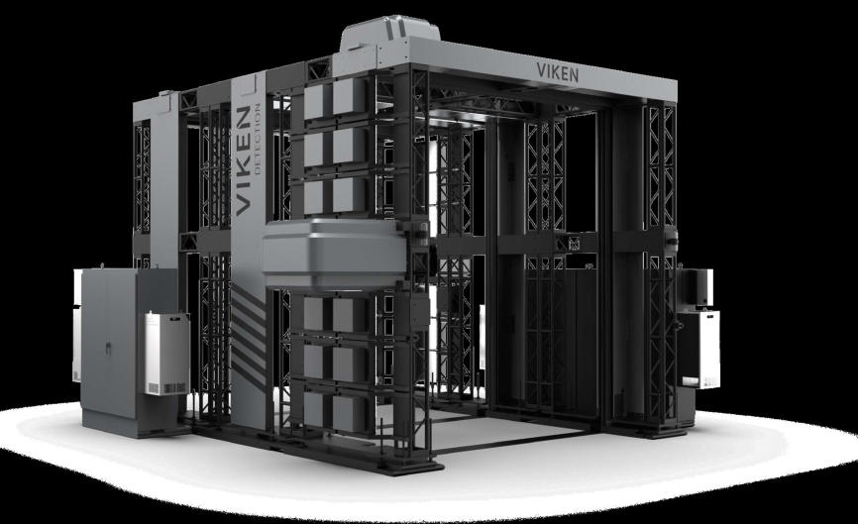
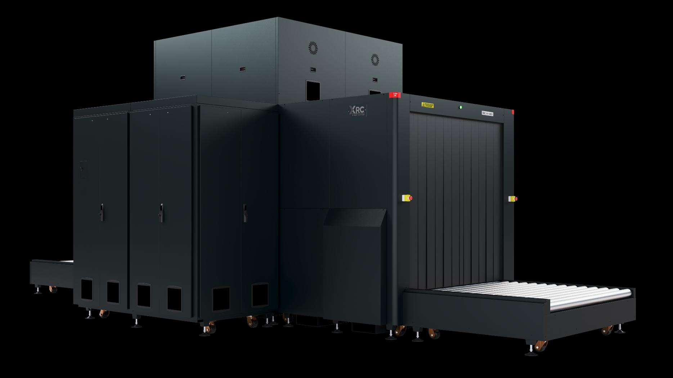
PRODUCT HIGHLIGHTS
A flagship from each partner
CEIA
SURESCAN
VIKEN
XRC
HI-PE Plus
DETECT™ 1000
HARRIER 3VX
180-180DV
Walk-through metal detector. 60 zones, very low nuisance alarm rate, IP66.
AI-powered CT cabin baggage. TSA L1 + ECAC EDSCB C3. No-divestment screening.
Three-sided drive-through scanner. Backscatter + dual-energy. No live source.
TSA ACSTL-qualified 320 kV pallet scanner. Largest tunnel in the family.
Allen & Co · Company Profile · April 2026
allenandco.ca

Slide 8
BEYOND HARDWARE
Maintenance, training & lifecycle support
1
Lifecycle maintenance
2
Operational training
3
Caribbean conditions
OEM-certified by all partner manufacturers
24/7 maintenance and repair support
Approved spare parts and diagnostics
Commissioning, preventive & corrective maintenance
Upgrades and life-extension programs
Partnership with FESTI at Toronto Pearson
NFPA 1001 Levels I & II
NFPA 1072 (HazMat Awareness)
ARFF certification
Realistic scenarios — fire, rescue, extrication
Tropicalised treatments for coastal corrosion
Heat & humidity-rated equipment
Stocking and parts logistics across territories
Field-resilient configurations
Local first-line response
Allen & Co · Company Profile · April 2026
allenandco.ca

Slide 9
WHY ALLEN & CO
What sets us apart
Regional first
“
01
Decades of Caribbean operating reality, not parachuted-in playbooks.
We stand behind every solution we deliver — long after installation and commissioning.
02
Internationally compliant
Equipment, training and processes that meet TSA, ECAC, ICAO and NFPA standards.
03
End-to-end accountability
From procurement through commissioning to 24/7 maintenance — one phone number.
04
People before paperwork
— Maureen Allen, CEO
Hands-on leadership that stands behind every install long after sign-off.
Allen & Co · Company Profile · April 2026
allenandco.ca

Slide 10
LET'S TALK
Ready to modernise your
security operation?
Allen + Co. Caribbean Inc.
Artemis House · 67 Fort Street · George Town · Grand Cayman KY1-1111
+1 (905) 703-6714 · info@allenandco.ca · allenandco.ca

